Slide 1
Partial Ordering of Events in Distributed Systems
A paper, by Leslie Lamport, published in the communications of the ACM
A talk, by Manan Shah

Slide 2
Introduction
Why?
Motivation
Lamport Clocks (Logical Clocks)
The Case of Idempotent producer in Apache Kafka (achieving “Exactly Once” Message delivery).

Slide 3
Motivation
Why not use the System Clock?
Clock Drift
Difference in the rate at which two clocks count time.
Over time, this drift would increase due to small imprecisions causing our clocks to go out of sync.
Shared Global Time Service ?

Slide 4
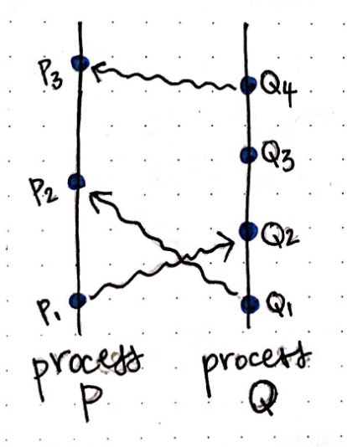
Lamport Clocks
Shift from happened when to happened before (known as causal ordering).
Use → shorthand notation to indicate the happens before relationship
For example,
If event ‘a’ happened before event ‘b’, we can say a → b.

Slide 5
Lamport’s Algorithm
All the process counters start with value 0.
A process increments its counter for each event (internal event, message sending, message receiving) in that process.
When a process sends a message, it includes its (incremented) counter value with the message.
On receiving a message, the counter of the recipient is updated to the greater of its current counter and the timestamp in the received message, and then incremented by one.

Slide 6
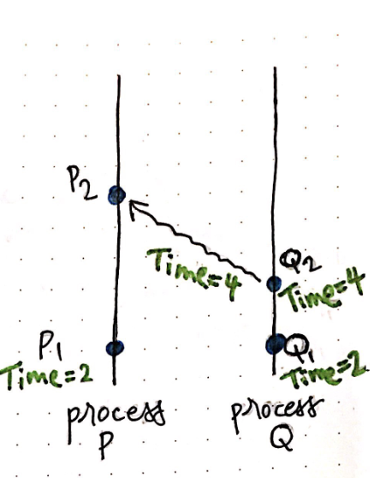
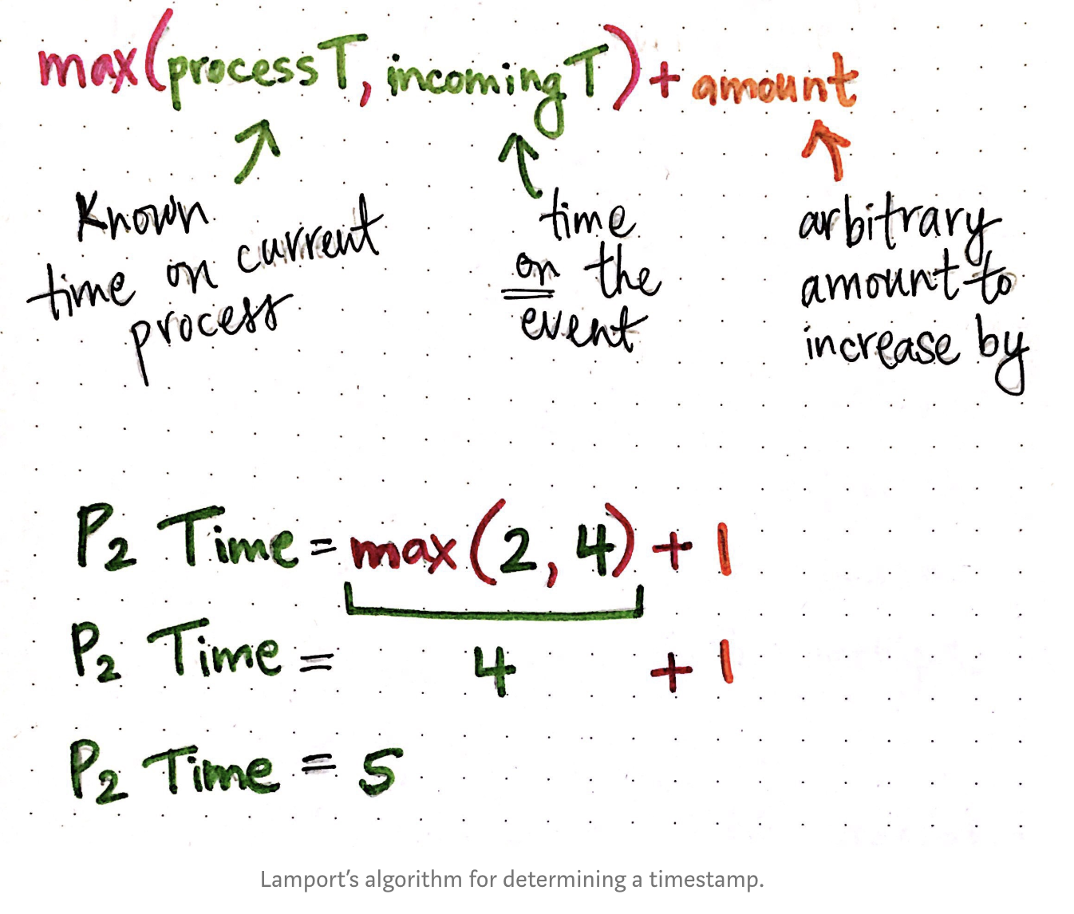
Example

Slide 7
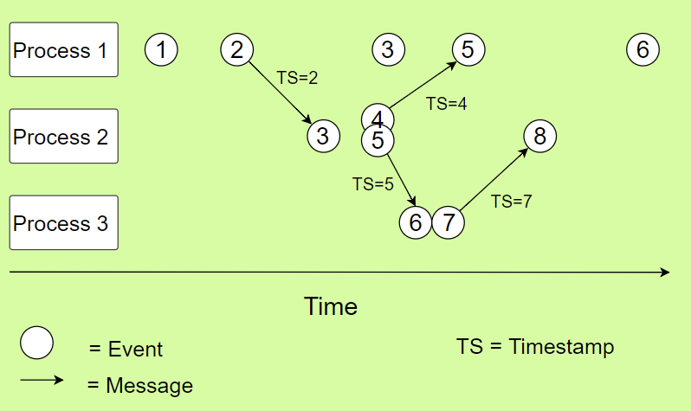
Example

Slide 8
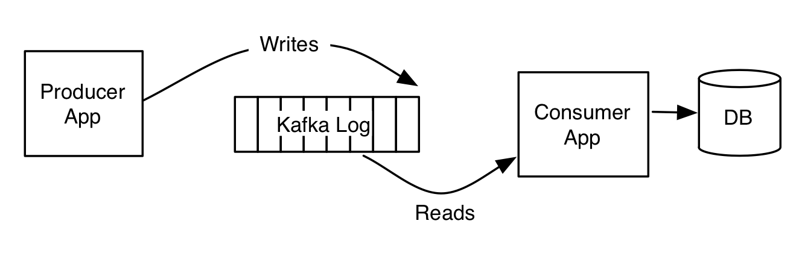
Kafka Architecture

Slide 9
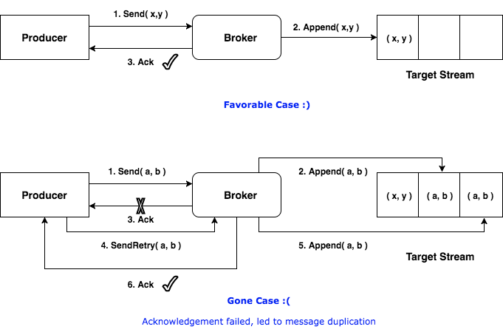
At least once delivery

Slide 10
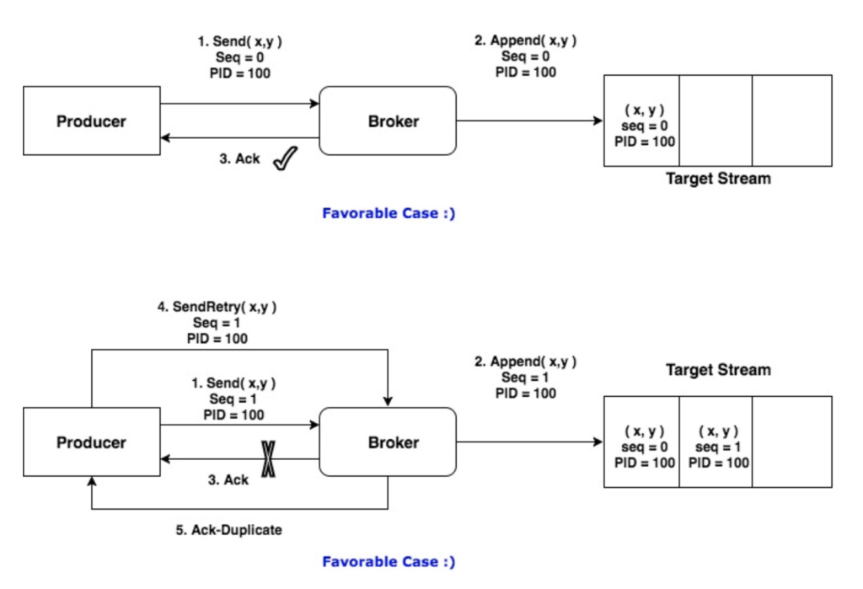
Idempotent Producer in kafka (Exactly Once delivery)

Slide 11
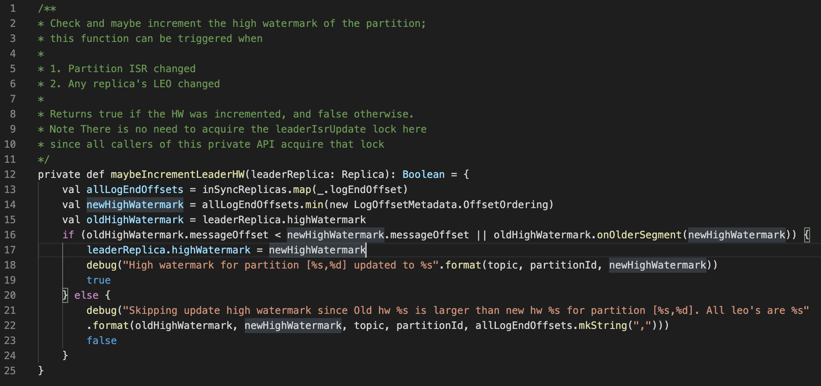
Code snippet

Slide 12
Thank You
Questions??

